Slide 1
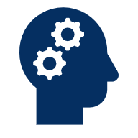
Introduction to Artificial Intelligence
Definition, History, Uses, Benefits, & Ethical Issues
Garnet Crocker
Notes:
“This week we’re going to talk about Artificial Intelligence, or AI. There is of course an enormous amount that could be said about this topic—many books have in fact been written about just this—but as our time is limited, we’re going to stay pretty high-level. This is not a technical lecture about math and algorithms and writing code. This is going to be a broad overview of what AI is, a brief history of how it developed, how it’s used, in particular some uses you might see in your daily lives, its benefits, and the big ethical and social questions surrounding it. As I’m sure you are all well aware, AI is becoming ever more widespread, so it’s becoming increasingly important that you have some general awareness about these topics.”

Slide 2
Part I: What is AI?
American Heritage Dictionary: “The ability of a computer or other machine to perform those activities that are normally thought to require intelligence.”
AI: Machines performing tasks requiring human-like intelligence.
Examples: understanding language, recognizing images, solving problems, making predictions.
Everyday examples: Siri, Netflix recommendations, self-driving cars.
Notes:
“[READ DEFINITION]. Now, since we as humans of course exhibit what we most often think of as intelligence, sometimes this definition is refined to say that AI refers to machines performing tasks that usually require human intelligence. [READ EXAMPLES] The common theme is that these systems mimic certain aspects of human thinking.”

Slide 3
The AI Effect
Once AI succeeds, we stop calling it AI.
Calculators were once 'AI' → now ordinary tools.
Spellcheck: cutting-edge in the 1980s, routine today.
Other examples: navigation, search engines, spam filters, chess engines
Notes:
“Now, the funny thing about AI, and the reason it can be tricky to define in practice is once it succeeds, we often stop calling it AI. This is sometimes called the AI Effect. For instance, calculators were once considered ‘artificial intelligence.’ Right, pretty incredible to just plug in advanced calculations and have a machine instantly solve them. Pretty human-like, even superhuman? Today, they’re just calculators. They’re commonplace, we don’t even think about them as that impressive, let alone as advanced AI. Even spellcheck was cutting-edge in the 1980s. Now, you hardly even think about it. Word processors all have spellcheck, your phone has autocorrect, and so on. Some other examples include: navigation, like Google Maps. Internet search engines, like Google. Email spam filters. And computer chess engines. Really take a moment to think about how crazy impressive each of these things are, and how they clearly are examples of AI. But when we talk about them nowadays, we don’t usually put the label of AI on them, or at least we don’t focus on that. In general, we most often tend to apply the AI label to things which are more modern and cutting edge. As technology becomes routine, we define it less often as AI.”

Slide 4
Evolving Definitions of AI
1950s: AI = machine doing what would be considered intelligent if a human did it.
1970s–1980s: Expert systems, encoding human knowledge.
2000s–today: AI as learning systems adapting with data.
Key idea: As AI improves, definitions shift.
Notes:
“Here is a bit more of a chronological breakdown of this concept creep of what AI is. Early in its history, in the 1950s, AI often had that broad definition of [SEE SLIDE]. By the 1970’s and 1980s, the focus was more specifically on expert systems that encoded human knowledge into rules. Today, AI most often refers to systems that learn from data, i.e., Machine Learning, which is just a subfield of AI. The key idea: [see SLIDE]. It’s interesting to think about: in a few decades, will we still commonly consider programs like Siri or ChatGPT ‘AI’?”

Slide 5

What AI is (Probably) NOT
AI is not magic.
AI is not conscious.
AI does not have human-level common sense.
AI does not 'think' like humans do.
AI is not your ‘friend’.
Notes:
“When we define what AI is, it’s also important to say what AI is not. AI is not magic. Now, there’s a famous quote by science fiction author Arthur C. Clarke: “Any sufficiently advanced technology is indistinguishable from magic.” And to a large extent, for the average person, this may be true of AI. Honestly, that is probably true in practice of a lot of modern technology. I’m sure most of us don’t really know the minute details of how electricity works, or a car engine works, etc. To a certain extent, with our limited knowledge, those seem sort of like magic, and AI is just the latest and greatest example of this incomprehensibly complex technology. But no, we know it is not magic. Just like other complex technology, it’s designed by humans, it’s understandable in large part by experts, etc.
Also, AI is not conscious, it does not have human-level common sense, and it doesn’t ‘think’ like a person does — it makes predictions and generates information based on an enormous amount of training data we feed it. It can recognize patterns, but it doesn’t really understand higher order concepts and reasoning in the same way that we do. Now, to be fair, there are people who dispute this. Some people already argue that we aren’t giving AI enough credit, or that we think too highly of our own human intelligence. They argue that it may be less different from us than we think, or at least that it could get to our level of cognition, maybe even sometime soon, despite being artificial. But the vast majority of people and experts disagree with that idea right now, and many simply disagree that is even possible in principle.
Similarly, AI is not your friend. By this, I do not mean that AI is your enemy, and I also do not mean that AI is not helpful, or that you might not like using AI. I just mean: AI does not have emotions, it is incapable of actually caring about you. But the fact that it can mimic emotions well has led to some big problems with people getting way too attached to AI, sometimes with disastrous consequences. We will talk a bit more about several of these issues when we touch on AI and Ethics at the end.”

Slide 6
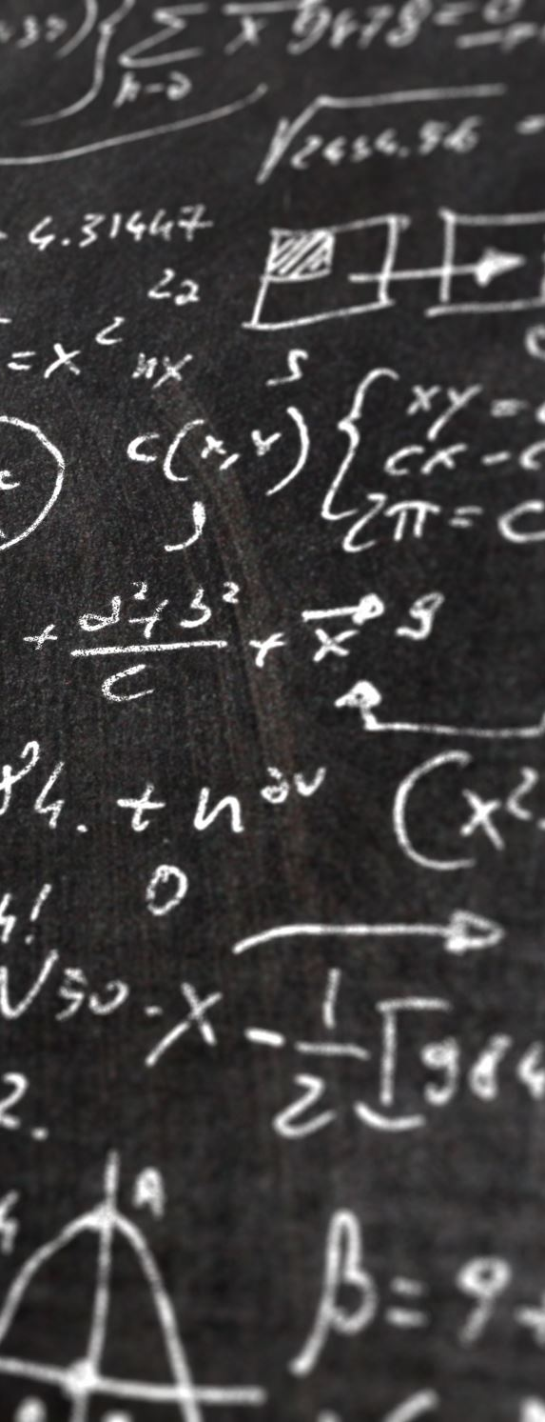
HOW AI WORKS (SIMPLIFIED)
Traditional, rules-based programming: Humans write explicit rules (if X then Y).
Machine Learning (ML): Systems learn patterns from large datasets.
Analogy: A child learning language through exposure, not rules.
Supervised learning: labelled data
Unsupervised learning: un-labelled data
Reinforcement learning: occasional feedback (Semi-supervised)
Training vs Testing data
Notes:
“Finally, on the topic of what AI is, very simply how does AI work? Well, AI systems are computer programs. Traditional programming means we write explicit rules: ‘if this happens, then do that.’ Some examples of AI, especially older, less sophisticated AI, are purely rules-based. Again, by AI in general we just mean that it can do things that seem intelligent, and certainly a rules-based system can seem intelligent. But as we said earlier, in modern times Machine Learning has come to the forefront of AI, and it flips this — instead of programming rules, we feed the system data and it learns patterns. Think of how a child learns language: not by memorizing grammar rules at first, but by listening and imitating.
Three commonly defined subfields of ML are Supervised, Unsupervised, and Reinforcement Learning. These are distinguished by the kind of training data that the model receives.
In Supervised Learning, the model receives labelled training data, and learns based on that.
In Unsupervised Learning, data is not labelled.
Finally, in Reinforcement Learning (semi-supervised), a model is given occasional feedback on its actions and decisions and it learns what is a good and bad decision based on that.
In all these cases, we can evaluate how good the model is on training data as we train it, and obviously we want it to perform well on training data. But the real test is after it is trained the model is given testing data that it has not seen before and we want to see how well it does on that.”

Slide 7
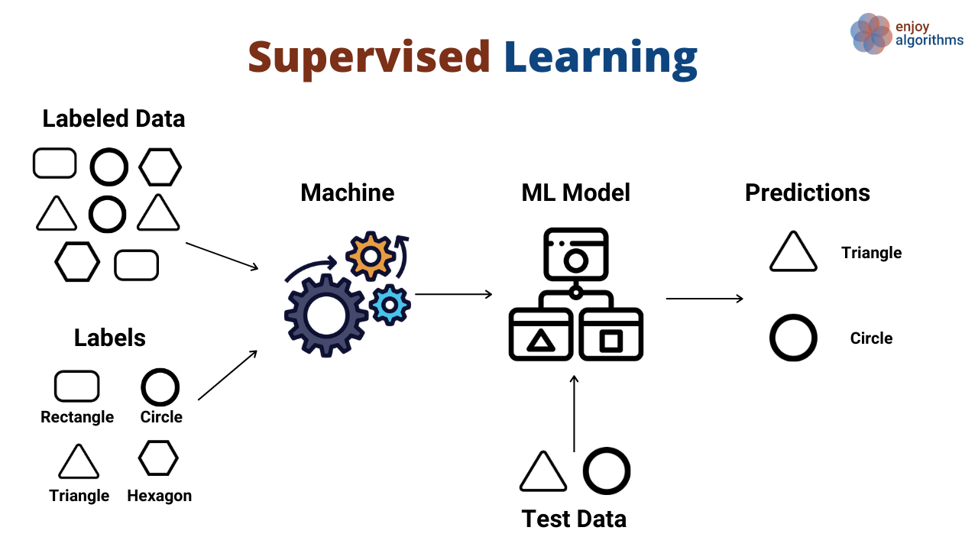
Supervised Learning
Supervised Learning
Give a model labelled training data
Have it “learn” a pattern which predicts/classifies based on the data
Evaluate its performance on separate testing data
Notes:
“In Supervised Learning, the model receives labelled training data. For example, you might give the model a dataset with lists of leaves and various attributes: color, shape, size, geographic origin, etc. And the leaves are labelled with the plant species they come from. Then in the future, when the model is given testing data, where we know all the attributes but we don’t know the species, it can predict the species based on the attributes. It has learned patterns in its training data to predict and classify testing data. [SEE SLIDE].”

Slide 8
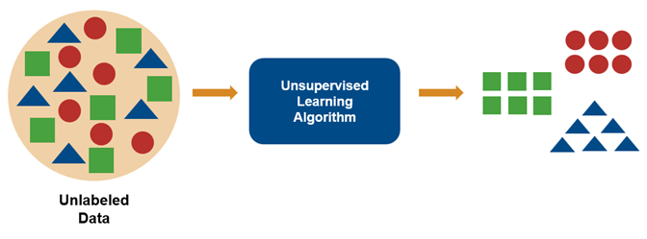
UNSupervised Learning
Unsupervised Learning
Give a model un-labelled training data
Have it “learn” a pattern which, e.g., “clusters” the data into groups.
Evaluate its performance on separate testing data
Notes:
“In Unsupervised Learning, data is not labelled. So, let’s say for example, we just give a model all our leaf data without any of the plant species being labelled. And we say: divide this into groups. The model will then try to cluster the data based on similarity. It can say: this leaf is probably of the same type as this leaf, because its size, shape, etc. are very similar. [SEE SLIDE]”

Slide 9
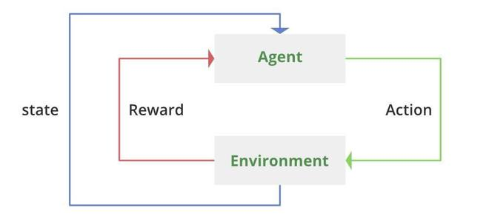
Reinforcement Learning
Reinforcement Learning
Give a model rewards based on actions taken in an environment
Have it “learn” a pattern which maximizes reward
Evaluate its performance on separate testing data (e.g., different environment)
Notes:
“Finally, in Reinforcement Learning, a model is given occasional feedback on its actions and decisions and it learns what is a good and bad decision based on that. This is very similar to human and animal psychology, and how we learn from experience. It is also often applied to game AI, since many games tend to have sparse rewards and involve exploration with many different choices. Our leaf example is not the best example for this, but let’s say that we have an AI agent which encounters leaves in its environment and labels them. If it labels them correctly, we give it a positive reward, and if it labels them incorrectly, we give it a negative punishment. The AI will then try to learn what behavior is triggering the reward, to learn what patterns it can follow to earn points. [SEE SLIDE].”

Slide 10
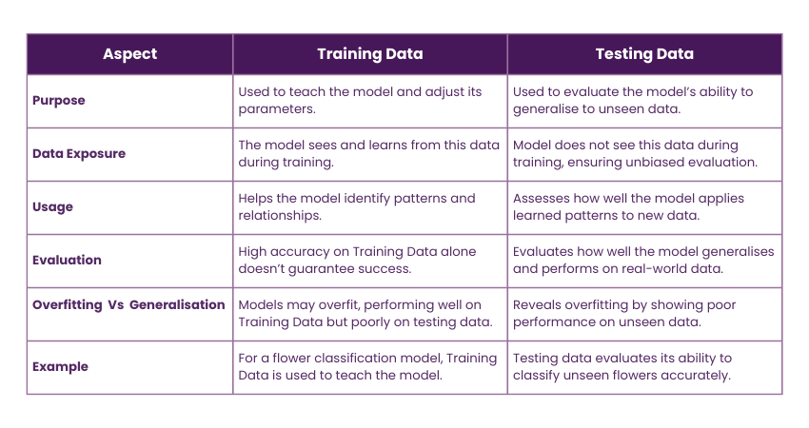
Training vs testing data
Training vs Testing data
Usually an 80-20 split
Bias-variance tradeoff, want models to generalize
Sometimes validation data
Notes:
“In all cases, we train the models based on part of our data, usually an 80-20 split: 80% training data, 20% testing. The point of this is we want the model to learn based on the training data, but be able to generalize its performance to the testing data. We don’t want it to just memorize the training data and fit that data perfectly by making a model that is “overfitting.” We want it to be able to perform well in a “real-world” scenario, where it doesn’t know what it will encounter. [SEE SLIDE] This is the key idea of the bias-variance tradeoff, which I’ll show a diagram of on the next slide. We also sometimes have this idea of the validation dataset, which is part of the data that we use like testing data during the training process in order to tune the parameters of the model better.”

Slide 11
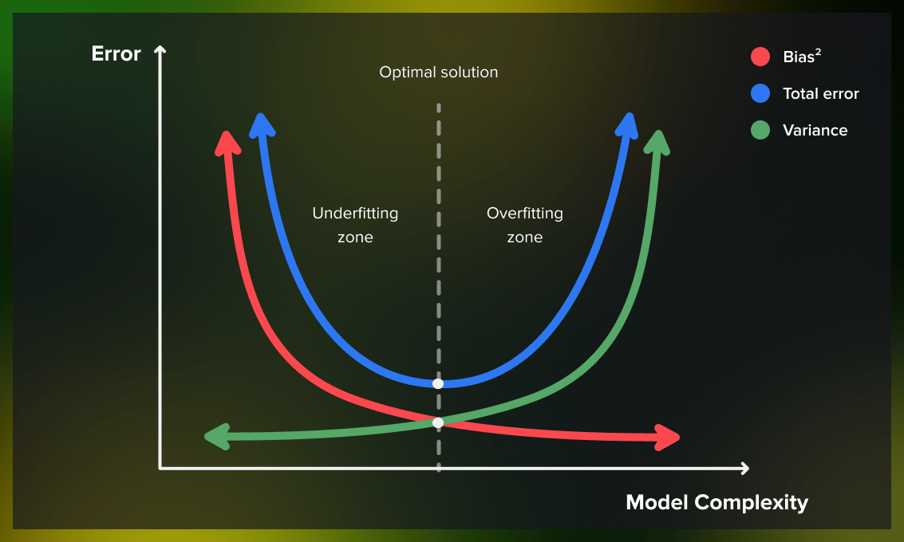
Training vs testing data
Training vs Testing data
Usually an 80-20 split
Bias-variance tradeoff, want models to generalize
Sometimes validation set
Notes:
“Here is what I was talking about with the bias variance tradeoff. When our model is very simple, we will have high total error because we are just getting things wrong. Our model is not complex enough to do well. Then, as we tune the model more and make it more complex, its performance improves, the error decreases. But eventually we hit the point where we start doing too well on the training data. We overfit to the training data, and we can’t generalize. We start doing worse on the testing data, and our total error increases. So we want to find this middle ground. On the left we say we have high bias—bias is error from wrong assumptions in the algorithm. We’re failing to fit the data well, we’re missing the pattern. But on the right, we say we have high variance—variance means error from sensitivity to fluctuations in the training data. In other words, we have fit the data too well—so well that if it changes at all, our error increases because we’re not actually learning a general pattern.”

Slide 12
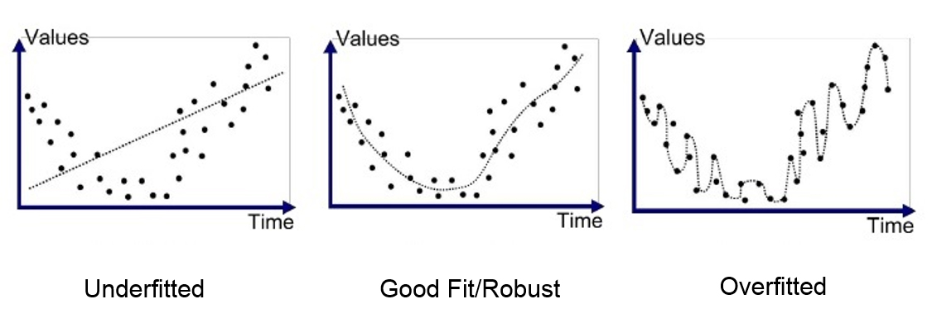
Underfitting & Overfitting
Underfitting & Overfitting
If you are not learning the pattern in the training data, you are underfitting. Your model is not complex enough and has high “bias”.
If you are simply mapping directly onto each data point and also not learning a general pattern, you are overfitting. Your model is too complex and has high “variance”.
This why it is important to have training and testing data. Bad on both = underfitting; good on training but bad on testing = overfitting.
Notes:
“This is a great series of simple graphs showing underfitting, overfitting, and a good model in between. Imagine that you have this data and the line is your AI/ML model. If you give the model a datapoint’s x coordinate, then it will predict its y coordinate based on the line of best fit that it has found. On the left, you can see that the model is definitely underfitting. It is not learning any pattern. The model is way too simple, something like y=x. It is performing terribly on the training data. On the right, in contrast, the model is performing perfectly on the training data. It has basically zero training error. But it is still a bad model. Why? Because it is not learning the general pattern. If you show it new, testing data, its accuracy will be bad. It is too complex, with some sort of long polynomial function. In the middle we see the best model. It fits to the data’s actual pattern; it has some training error, but not too much, and if we get more testing data we expect it to do better than the other two. Its complexity is in between the other two, in the sweet spot of generalizing good performance. This is why it is crucial to have both training and testing data; the most important measure of a model’s performance is on the testing data, not on the training data. The testing data proves whether it has actually “learned”.”

Slide 13
Part II: History of AI
How did AI develop from theory to today's apps?
Notes:
“Now that we have an idea of what AI is, we’ll do a brief rundown of how AI developed.”

Slide 14
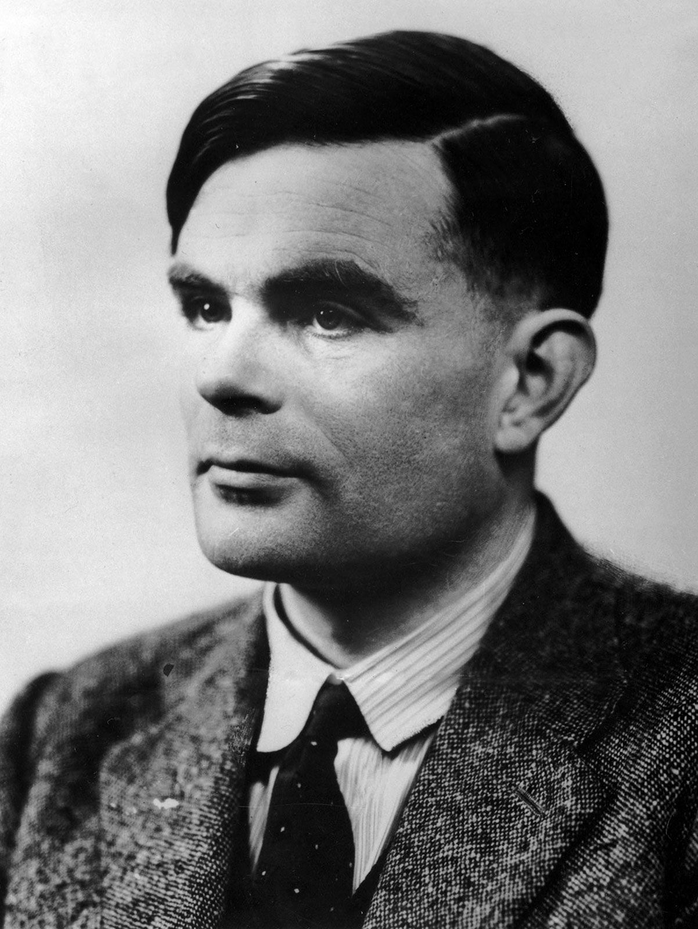

Early Visions
1950: Alan Turing proposes the Turing Test: ‘Can machines think?’
‘The Imitation Game’
Notes:
“This is British mathematician Alan Turing, one of the founding fathers of AI. He is famous for several things, including helping military intelligence crack the Nazi cipher code Enigma during World War II. The movie The Imitation Game, starring Benedict Cumberbatch, is about that. He is also extremely famous for proposing the idea of the Turing Test in 1950. This was a theoretical test that he proposed to determine whether a computer can think. The idea was “the imitation game,” which is where the title of the movie comes from. You would have a remote human interrogator, who can’t see the subjects, ask questions of both a human and a computer. If the interrogator is unable to distinguish between the two, then the computer has satisfied the criteria of ‘thinking’.”

Slide 15
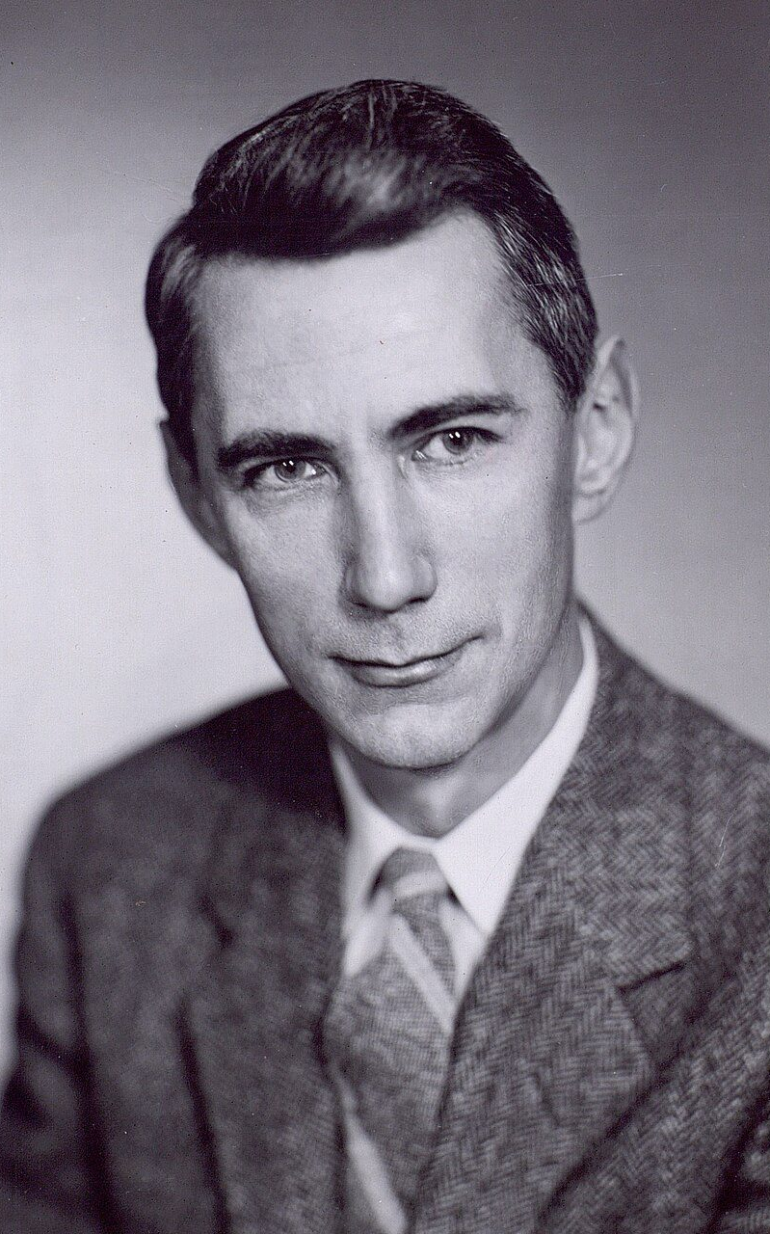
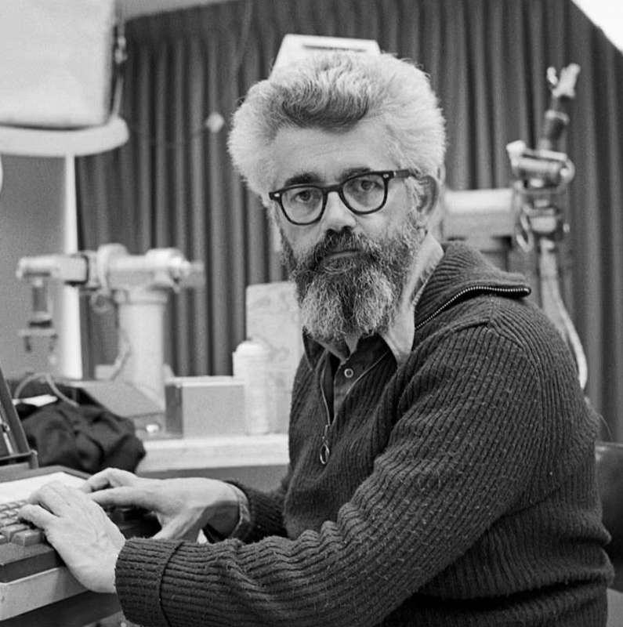
BIRTH OF ‘ARTIFICIAL INTELLIGENCE’
1956: Dartmouth workshop
The term ‘Artificial Intelligence’ is coined
Claude Shannon, John McCarthy, Marvin Minsky, Nathaniel Rochester, etc.
Notes:
Then, in 1956, there was a conference at Dartmouth: the Dartmouth Summer Research Project on Artificial Intelligence, featuring several other brilliant scientists who are now regarded as founding fathers of AI. In a proposal they wrote for the conference, four of these men, Claude Shannon, John McCarthy, Marvin Minsky, and Nathaniel Rochester coined the term ‘Artificial Intelligence’ and launched AI as a defined academic field.

Slide 16
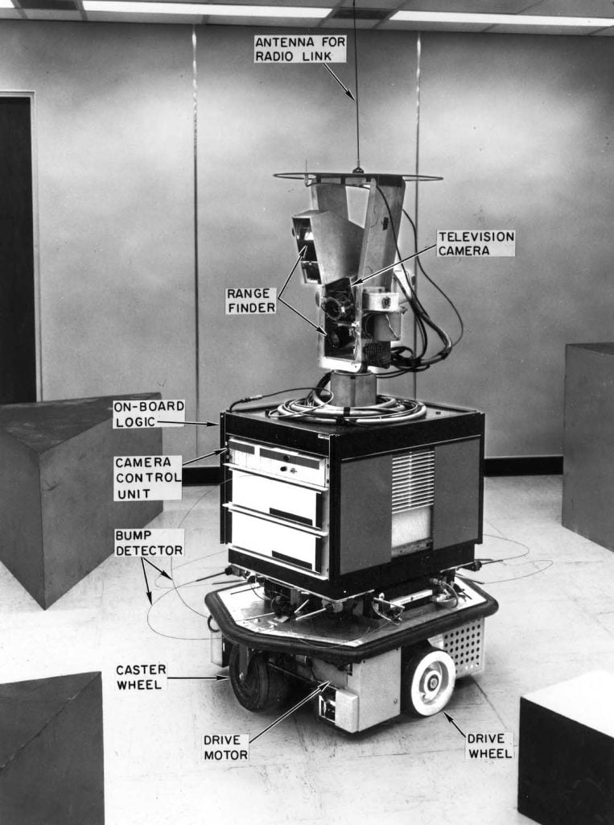
1960s–1970s: Early Optimism
Robots like Shakey (1966).
Expert systems such as MYCIN (medical diagnosis).
Notes:
“The 1960s and 70s saw early robots like Shakey, which could navigate a room. Expert systems like MYCIN tried to diagnose medical conditions, identifying bacteria which caused infections. There was great optimism — some believed machines would soon rival human intelligence. You probably know that lots of popular media of the time predicted the future and the space age would be this wondrous time with flying cars, robotic assistants, etc. and that it would be happening within just a few decades.”

Slide 17

AI Winters
1970s–1990s: Funding cuts after hype exceeded results.
Slowed progress, but research continued.
Term coined by Roger Schank and Marvin Minsky at 1984 annual meeting of the American Association of Artificial Intelligence (AAAI)
Notes:
“But some of that was too optimistic. Progress was slow, there weren’t as many major breakthroughs as expected, and academic funding dried up. The 1970s–1990s are remembered as ‘AI Winters.’ During these periods, research continued quietly, but AI wasn’t in the spotlight.”

Slide 18
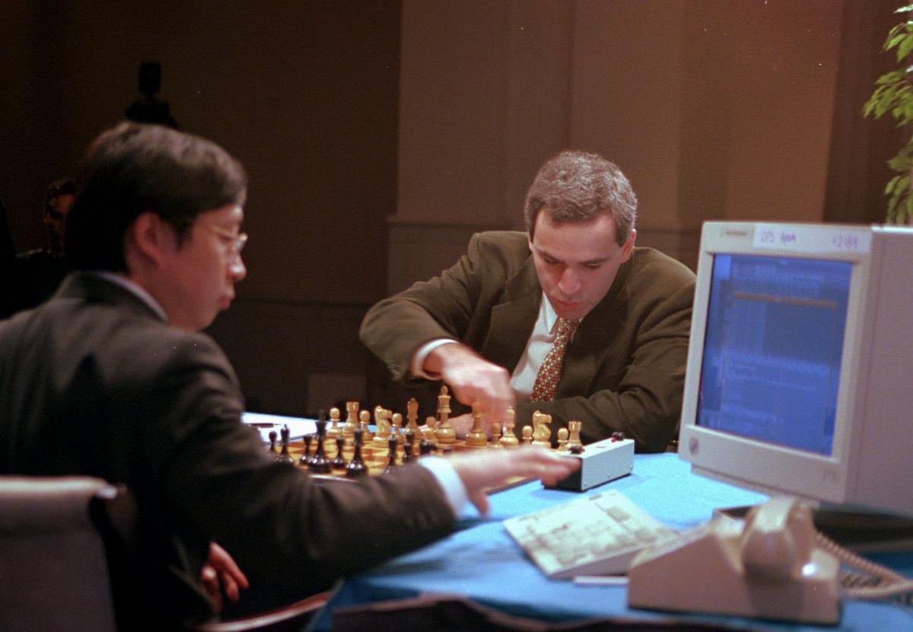
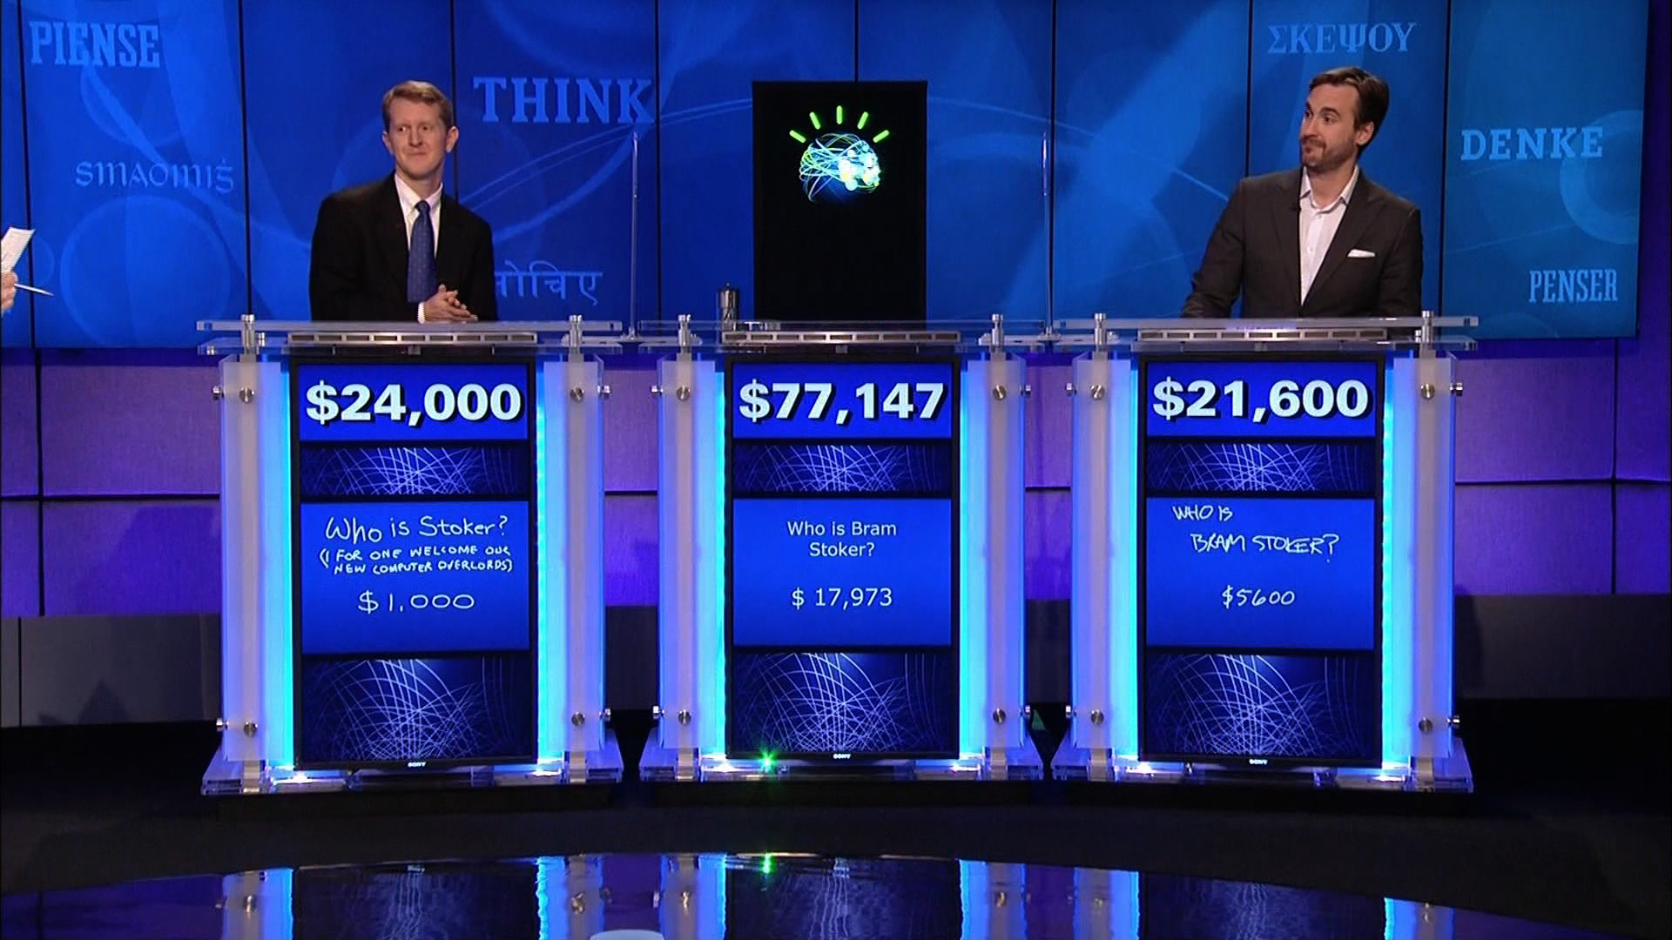
Key Milestones
1997: IBM Deep Blue defeats Garry Kasparov in chess (in a rematch).
2011: IBM Watson wins Jeopardy!
2016: AlphaGo defeats world champion Lee Sedol.
Notes:
“Then, starting in the late 90s, AI started to get back into the public spotlight with sensational achievements. In 1996, an IBM supercomputer named Deep Blue had played the current world chess champion Garry Kasparov, widely considered one of the greatest chess players of all time. Kasparov won that 6 game match 4-2. But in a 1997 rematch, Deep Blue was victorious, winning 3.5-2.5. Now, as I said before, chess engines have become one of those things that we might not even term cutting-edge AI. They are now way better than humans, and have become commonplace, but at the time this was a historic achievement. In a game which relies on deep, complex, long-term calculation and planning, computers had become superior to humans. In 2011, IBM Watson won Jeopardy! against top human players. This was a computer capable of natural language processing, information retrieval, automated reasoning, etc. And in 2016, Google’s AlphaGo beat Lee Sedol, the world champion in Go — a game far more complex than even chess.”

Slide 19
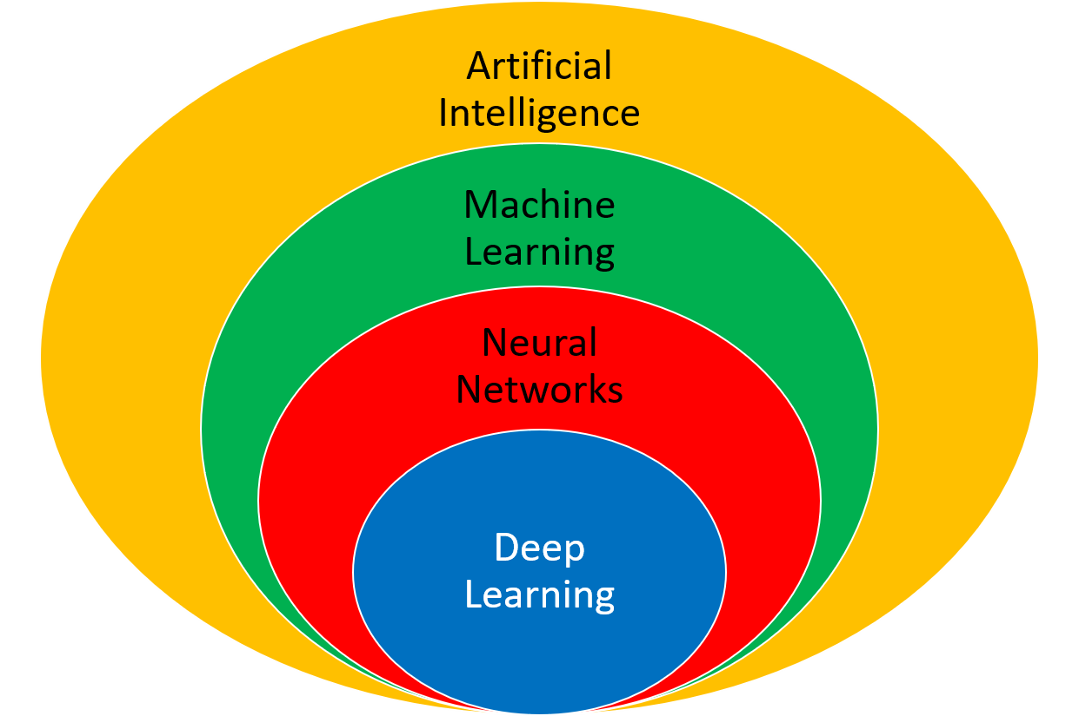
AI Today
2010s–2020s: Deep learning, increased computing power, big data revolution.
Everyday AI: Google Translate, Siri, Netflix
Large Language Models (LLMs): ChatGPT, Claude, Gemini, LLaMA, Grok
Image, voice, and video generation: DALL-E, Stable Diffusion, MidJourney, Adobe Firefly; ElevenLabs; Runway, etc.
Notes:
“Since the 2010s, AI has exploded, both in popularity and in effectiveness. There are several reasons for this. One is the development of Deep Learning, which is a subfield of Machine Learning that uses complex AI models known as neural networks, so named because the idea behind their design is somewhat similar to the neurons in human brains. Another reason is the increase in computing power with technological advances. Computer processing units have only continued to get smaller, more efficient, etc. And a third is the so-called rise of big data—the harvesting of massive datasets that can be fed into these machine learning models. Now AI is no longer confined to labs, or supercomputers, or narrow expert systems — it’s embedded in everyday technology. Google Translate, Siri, Netflix, and many others are used in our daily lives. And most recently, there has been the advent to the public of Large Language Models, which can understand human text and speech, respond to prompts in extremely convincing and intelligent ways, write novels, poetry, code, and so on. Some examples include OpenAI’s ChatGPT, Anthropic’s Claude, Google’s Gemini, Meta’s LLaMA, X’s Grok, etc. Around the same time, there’s also been the explosion of publicly available tools for image, voice, and video generation, here just listing a few examples, mostly of image generation tools.”

Slide 20
Part III: AI in Everyday Life
AI powers many tools you already use daily.
Notes:
“So, what are some places that you might see AI used today?”

Slide 21

Social Media
TikTok/Instagram: personalized feeds.
Content moderation algorithms.
Notes:
“TikTok and Instagram use AI to create personalized feeds. You’ve probably all heard the term “the algorithm”. The algorithm shows me this, my algorithm is feeding me this, etc. These social media platforms have complex AI/ML tools to learn your habits, your likes and dislikes, what you will interact with, etc. These algorithms decide what you see, based on what they predict you’ll like. AI also helps moderate harmful content, although not always perfectly.”

Slide 22

Streaming & Shopping
Netflix/Hulu: recommendation engines.
Amazon: 'Customers also bought' suggestions.
Notes:
“Similarly, just like social media platforms recommend posts for you, so too do apps like Netflix and Hulu recommend shows or movies based on your viewing history. Amazon suggests products under ‘Customers also bought.’ These recommendations are AI-driven — and they influence what you consume.”

Slide 23

Navigation & Voice Assistants
Google Maps, Waze: traffic predictions.
Siri, Alexa, Google Assistant: natural language interaction.
Notes:
“Google Maps and Waze predict traffic patterns using AI. Siri, Alexa, and Google Assistant process natural language, allowing you to ‘talk’ to your devices.”

Slide 24
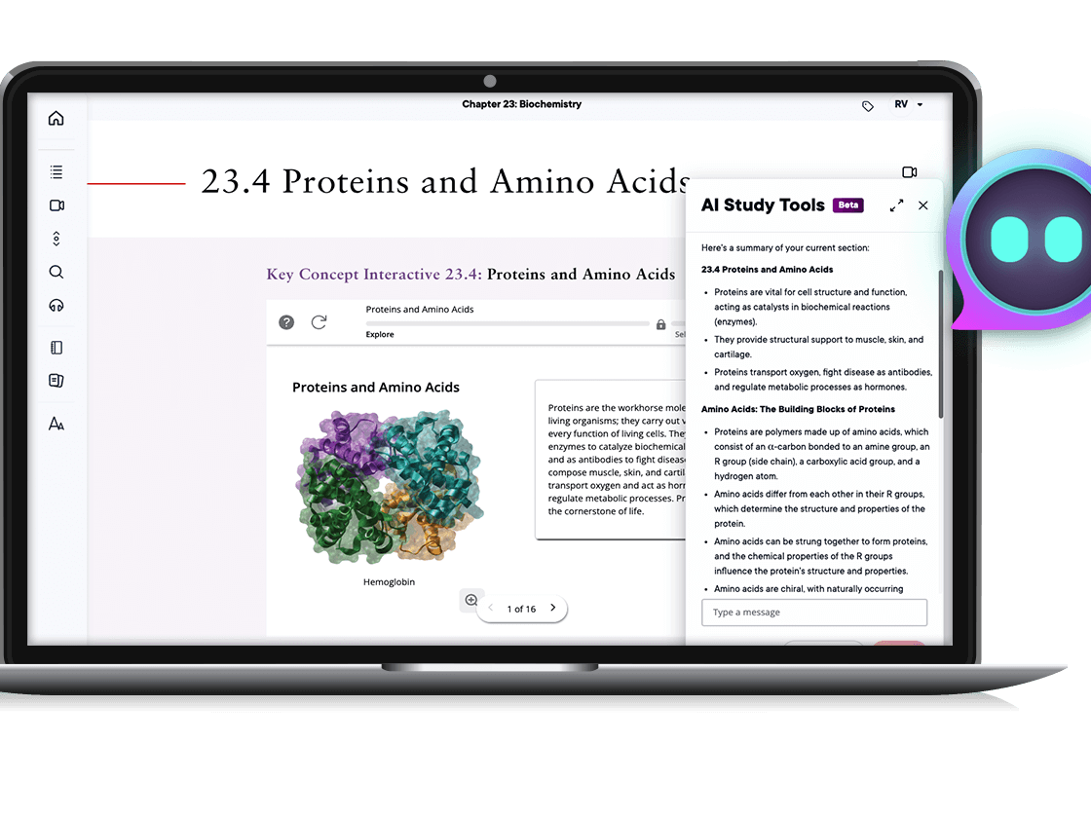
Education Tools
Grammarly: grammar & style suggestions.
Duolingo: adaptive language learning.
Pearson eTextbook AI study tool
Notes:
“Grammarly uses AI to suggest grammar and style improvements. Language learning apps like Duolingo adapt lessons to your learning pace. Tons of educational websites now use AI tools to help you study. Our old friend Pearson, as I’ve showed you before has that AI study tool built into its textbook.”

Slide 25
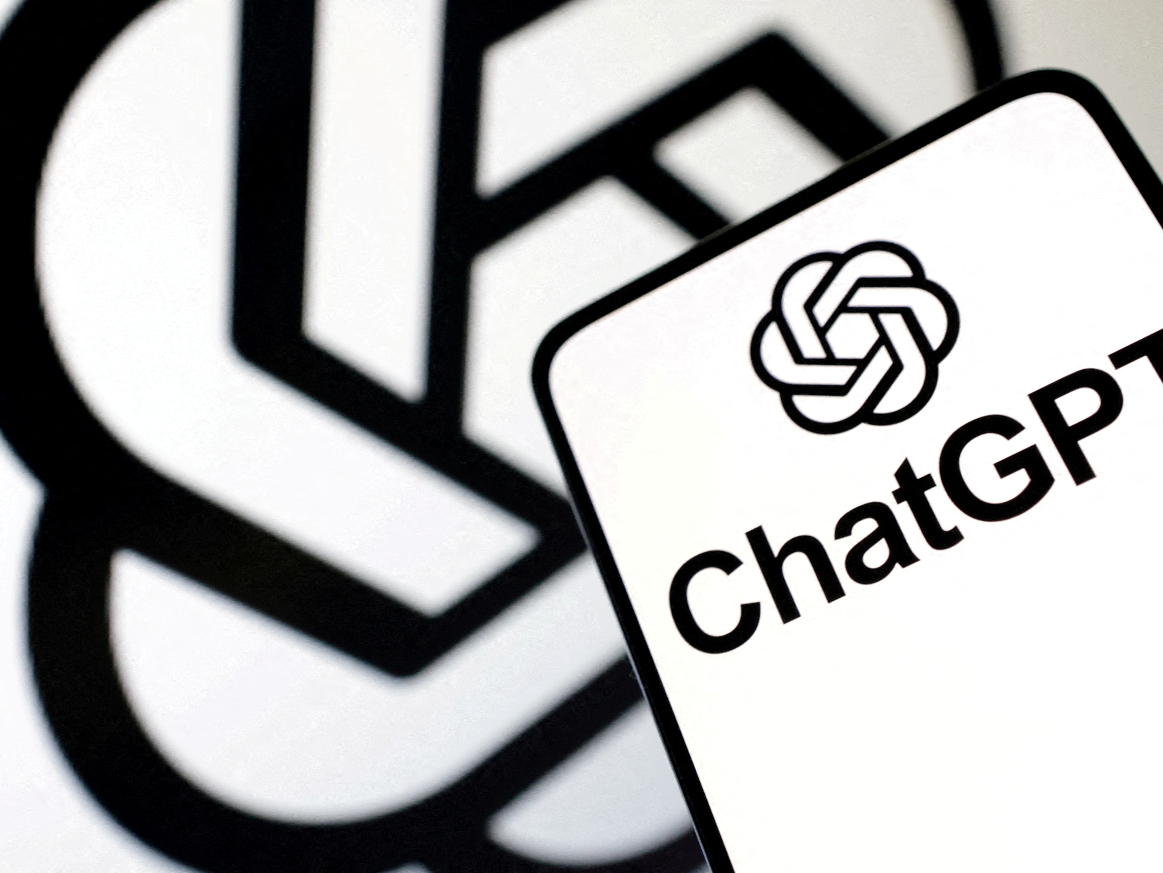
Many, Many more
Many websites’ AI chat support
LLMs like ChatGPT
Image generation tools
Video game AI
Notes:
“As I said, tons of educational websites use AI tools. Quite frankly, at this point it feels like most websites have some sort of AI tool, like AI chat support. Also, we mentioned these in the last section, but of course LLMs like ChatGPT, image gen software. Most video games have some sort of AI, for opponents you encounter and whatnot, to try to make behavior realistic, challenging, etc.. I’m sure you could probably think of many other examples. The point is: AI is all around us, it’s only getting more widespread, it’s only getting more sophisticated, etc.”

Slide 26
Part IV: AI in Microsoft Office
AI integration in everyday productivity tools.
Notes:
“Briefly, since this is the focus of this class, I want to touch on how Microsoft Office has integrated AI in a couple ways. And again, we’ll talk about some of this more when we get into Office specifically, but just to touch on the topic briefly.”

Slide 27
Microsoft Word
Spelling, grammar, and style corrections.
Microsoft Editor for clarity suggestions.
Notes:
“Word uses AI for grammar, spelling, and style suggestions. Microsoft Editor now even suggests tone improvements, helping with clarity and conciseness. Or you can of course use other AI writing tools to generate/edit text and then put that into Word to create your final product.”

Slide 28
Microsoft Excel
Predictive analytics, auto-complete, charts.
Data insights using machine learning.
Notes:
“Excel’s predictive features suggest formulas, auto-complete entries, and create charts automatically. It uses AI to find patterns in your data.”

Slide 29
Microsoft PowerPoint
Designer tool suggests layouts and visuals.
Can automatically re-format text, images, etc.
Notes:
“PowerPoint’s Designer tool suggests slide layouts and visuals. It can automatically re-format text, images, and what not, and suggest little icons to go with text. For most of these slides, I used suggestions from Designer. That’s why these all follow this similar format.”

Slide 30
Microsoft Access and Copilot
Data can be exported to AI analysis tools.
Integration across Office with Microsoft Copilot.
Notes:
“Access itself does not have as many AI features, but there are a bunch of ways you could connect AI tools to data you have in Access. For example, the most straightforward way is just that data can be exported into a separate tool like Excel, Power BI, etc. for AI-driven analysis, natural language queries, cleaning the data with AI tools, etc. Additionally, Microsoft’s Copilot feature integrates across all of Office to act as an AI assistant. It can draft reports, summarize documents, analyze data, and so on.”

Slide 31
Part V: Benefits of AI
Why is AI valuable?
Notes:
“So why all the excitement about AI? Let’s look at the positives.”

Slide 32

Efficiency & Productivity
Handles massive datasets quickly.
Automates repetitive tasks.
Notes:
“Probably the most obvious reason AI is useful is that it can do things that humans can do, but do them way more efficiently, way faster. For example, it can analyze huge datasets in seconds, automate repetitive tasks, and free humans for more creative work. Think of factory robots or an AI summarizing meeting notes.”

Slide 33

Accessibility & Safety
Translation tools break language barriers.
Assistive tech for disabilities.
Robots handle dangerous environments.
Notes:
“AI makes tools more accessible. Translation services break language barriers. Screen readers help people with disabilities. You may have seen this news story that this man (Noland Arbaugh), who is a quadriplegic unable to use his limbs, is the first patient to have a Neuralink chip implanted in their brain. That chip can electronically detect his brain activity and allow him to perform certain actions, like moving a computer mouse to play video games, online chess, etc. Robots can also enter hazardous environments, reducing risks to humans.”

Slide 34
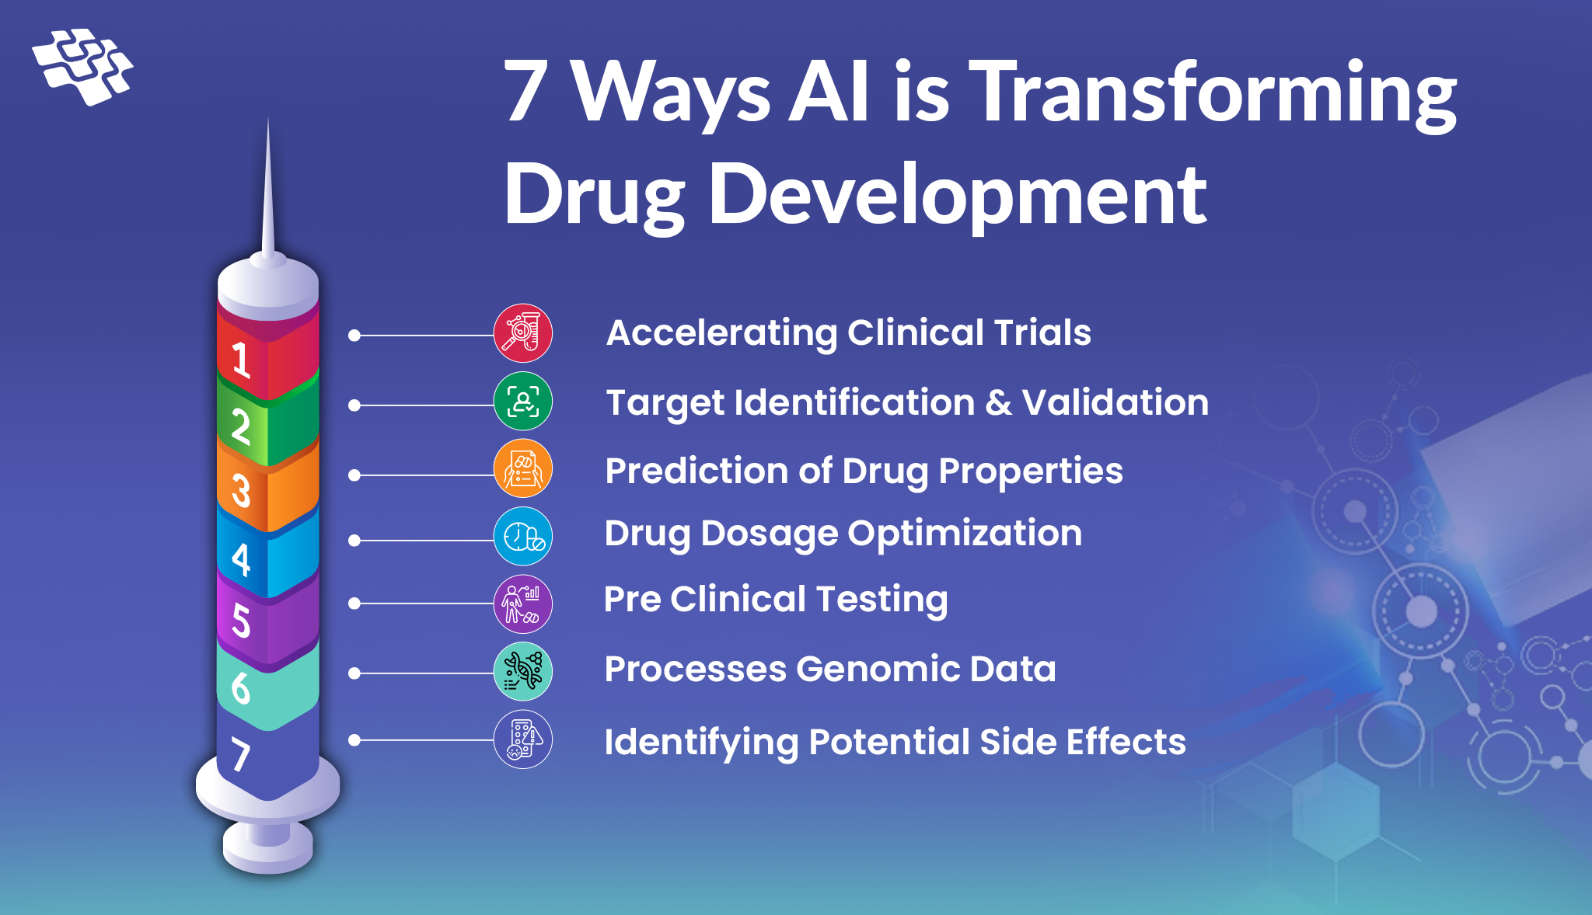
Innovation & Creativity
AI generates new art, music, designs, writing, etc.
Helps scientists in drug discovery and research.
Notes:
“Now there are people who dispute this, but you could argue that AI is not just functional — it’s also creative. As I said, you could have a long philosophical argument about what being creative actually means and whether AI is truly capable of being creative, but it is undeniable that, given input data, AI can generate art, music, designs, writing, poetry, etc. which is ‘new’, which is ‘novel’. It is certainly based on training data; an AI cannot generate information from nothing, but in that sense it is arguably similar to human creativity. In scientific fields, AI helps researchers discover new drugs or materials. This is because AI can spot chemical structures that look promising much faster than humans, and can simulate how a molecule will behave in the body, predict side effects, or estimate effectiveness before lab tests. This will lead to faster discovery and development of medical treatments.”

Slide 35
Part VI: Ethical & Social Issues
Opportunities come with major challenges.
Notes:
“Of course, although AI has many benefits, it also has many potential issues.”

Slide 36
Bias & Fairness
Amazon hiring tool—biased based on gender
COMPAS (Correctional Offender Management Profiling for Alternative Sanctions) predicting criminal recidivism—biased based on race
MIT study on facial recognition technology—biased based on gender and race
Optum healthcare risk-prediction tool—biased based on race
Apple’s credit card—biased based on gender
Notes:
“First, Bias and Fairness. An AI system is only as good as its training data, and it is often possible for training data to be biased, for a wide variety of reasons, which are often unintentional and unforeseen. For example, Amazon between 2014 and 2017 used an AI tool to help provide recommendations on potential job candidates, but they discovered that its recommendations were problematic, because among other things, it was biased in favor of hiring men over women. Why? Well, not because of any nefarious backroom scheme, but simply because of the training data. Most people in tech roles, especially at the time, were men, and additionally the model was trained to favor certain verbs that showed up more often on men’s resumes, such as “executed” and “captured”.
Similar issues of bias have been raised in a multitude of other areas, such as predicting the likelihood of criminal recidivism (re-offense); far higher error rates in facial recognition technology on for example black women vs white men; underestimating patient healthcare risks based on race; lower credit limits being given to women with Apple’s credit card, etc.
Again, I want to reiterate: these biases were almost certainly not intentional. Rather, they were the unforeseen results of the data these models were trained on, or the assumptions that were made in their development. For example, in the case of the Optum healthcare tool, the idea was that healthcare expenditure would be used to predict healthcare risk; in other words, if you are spending more money on healthcare, you are more likely to need more healthcare. That seems like a very reasonable assumption, at first glance. For a variety of reasons, however, on average, black people spend less on healthcare than white people. This led to it being the case that the model would predict a white patient and a black patient had the same health risk and health need because they spent the same amount, even though the black patient was actually sicker, and had a greater need.”

Slide 37
Transparency & explainability
Trust
Higher-risk applications require a higher-level of trust—e.g., self-driving cars
Model transparency
Data transparency
Process transparency
Explanatory and interpretable results
The rise of deep learning “black boxes”
Feature importance, image saliency maps, NLP attention maps, etc.
Notes:
Second, Transparency and Explainability. The more that we allow AI to conduct an ever increasing number of complex tasks, the more we need to be able to trust it. One way to trust something is just because it is effective. If something works, don’t ask questions; if it ain’t broke, don’t fix it. But we oftentimes want more than that. We want to know why an AI model gave a certain answer. This is especially the case when we are dealing with higher-risk applications of AI, and is even more especially the case when things inevitably do go wrong, at least occasionally. You might for example, think of self-driving cars: let’s say we get to the point where self-driving cars are clearly safer than human drivers. It will still be the case that just a few instances of self-driving cars causing accidents will cause an uproar. Why? Because those accidents will feel more preventable than accidents caused by humans, and people will demand to know what went wrong with the AI.
There are several kinds of transparency: model transparency is a clear explication of how an algorithm actually works: its structure, parameters, etc. Data transparency is a clear understanding of the training data that we feed into the model, and its potential biases, as discussed above. Process transparency is being open about the overall design, and the decisions that support the other two areas. Why did we decide on this kind of model, or this data, how are we analyzing our results, etc.
And, in terms of results, one of the most important parts of this is we want to be able to explain our results. With some models, this is quite straightforward, like simple linear regression, or K-nearest neighbors, decision trees, etc. Increasingly, however, AI has become centered around big data, and big models, in particular deep neural networks with many layers, tons of parameters, etc. In those cases, it becomes basically impossible to give an exact explanation of why a result was given, and we must resort instead to various methods to determine such things as feature importance, and so on.

Slide 38
Academic Honesty
The widespread use of Large Language Models (LLMs)
Cheating is easier than ever and more difficult to detect than ever
Use of AI by teachers—Northeastern University student demands refund
Many potential benefits…but many potential risks
Can be alleviated by detection, repercussions, proctoring, in-class assignments, responsible and limited AI use, etc.
Ultimately, an important ethical issue
Notes:
Third, Academic Honesty is of course a specific ethical issue that directly concerns all of us. In the age of AI tools, and in particular with the rise of LLMs like OpenAI’s ChatGPT and numerous others, it has become increasingly easy for students to be dishonest in their work, and increasingly difficult to detect that dishonesty. Students can write essays, or solve math problems, or generate code with little effort or learning of their own. Teachers can themselves use various AI methods to detect the cheating, but those will of course never be perfect, and students can always invent clever methods to win that cat and mouse game.
On the flip side, teachers have also received criticism for the use of AI tools to assist them in their teaching. You may have heard this news story from earlier this year where a senior at Northeastern University discovered that her teacher was using ChatGPT to make notes and presentations, and filed a formal complaint to request reimbursement for that class. Her complaint was eventually rejected, but there have been and will continue to be similar examples. Obviously, as students you want to know that your teachers have actually put some effort in and have some knowledge on a topic, and that they’re not just parroting AI tools. Similarly, as a teacher, I want to know that you all are actually trying to learn, and not just using AI tools to give you answers.
The point is: it goes without saying that there are numerous potential benefits with the use of AI in academics—right, we talked about the use of AI in education tools, and this is not to say that AI cannot be an extremely useful tool--, but there are many risks and problems as well. These can be alleviated by the use of detection tools, disciplinary actions and repercussions to dissuade cheating, more proctoring of exams and assignments, requiring more in-person, in-class assignments and presentations, perhaps allowing and teaching students to use AI in certain limited fashions, etc. At the end of the day, however, this is simply a classic ethical issue: will you do the difficult but right thing, even if you can get away with doing the easy but wrong thing. If you truly want to learn and improve as a person, then obviously the answer should be yes.

Slide 39
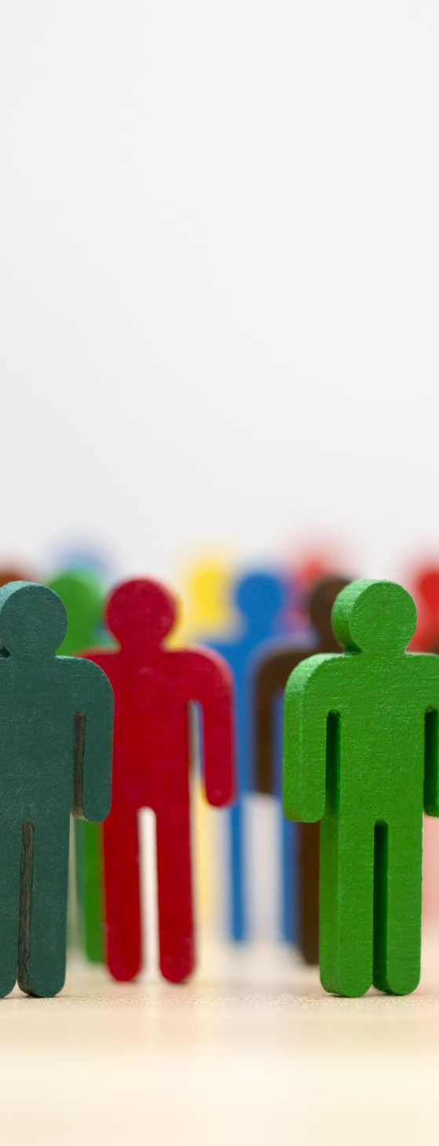
Accountability & responsibility
Who is responsible when AI makes mistakes? For example, “AI Hallucinations”
Shared responsibility: developers, companies, users
Importance of transparency and oversight
Notes:
“This ties into the idea of transparency, but it goes beyond that. AI systems are used in decisions that have important outcomes for real people. So when an AI system makes a decision — like denying someone a loan, misidentifying a person, or even causing harm in healthcare — who is responsible? Is it the programmer? The company that deployed it? Or the end-user? These questions get at the heart of accountability in AI. Without clear responsibility, people may be harmed without recourse. This is why oversight, auditing, and transparent decision-making are so important in AI systems, and why we likely are going to need more regulation around AI usage.”

Slide 40
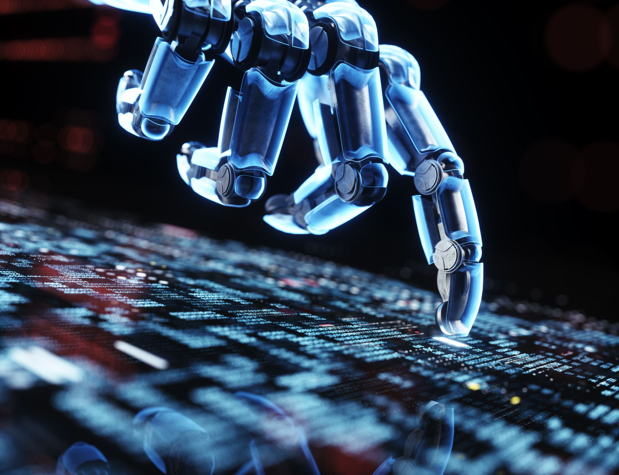
Harmful Applications
AI in autonomous weapons
AI for cyberattacks and scams
Misuse by authoritarian governments
Notes:
“AI can be used for good, but it can also be weaponized. Military AI raises the prospect of autonomous weapons making life-or-death decisions. Hackers can use AI to create more sophisticated phishing attacks. Governments may misuse AI for mass surveillance or oppression. These possibilities highlight why global ethical discussions and regulations are necessary.”

Slide 41

Copyright laws & fair use
AI trained on copyrighted works
Who owns AI-generated content?
Ongoing legal disputes
Notes:
“Many generative AI tools are trained on books, art, music, and code scraped from the internet. But this raises the question: is that fair use, or copyright infringement? If an AI produces a painting in the style of Van Gogh, who owns the copyright — the user, the AI’s developer, or no one at all? Courts around the world are currently wrestling with these questions, and the answers will shape the future of AI creativity.”

Slide 42
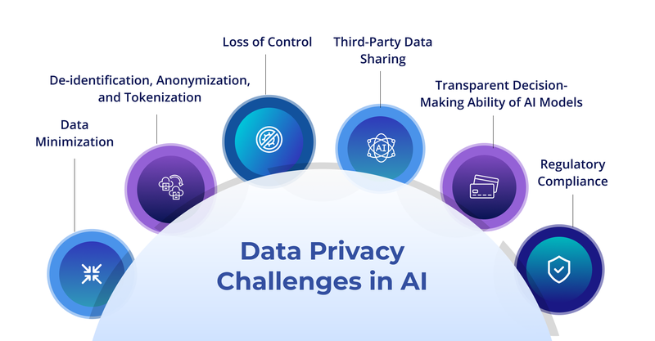
Privacy, Surveillance, & data harvesting
AI relies on massive personal datasets
Risks of surveillance capitalism
Facial recognition and tracking raise concerns.
Striking balance: security vs. privacy
Notes:
“AI systems often depend on enormous amounts of personal data — from your clicks, location, and browsing history, to biometric information like your face or voice. We talked earlier about how social media platforms have algorithms to serve you personalized content based on your data. That’s pretty cool, but at the same time these are advanced programs created by billion-dollar companies in order to make you spend as much time as possible on their platforms, to interact with as many ads as possible, to give them as much data as possible. They are of course trying to make money, and that means making money off you. There is a quote in the Netflix documentary ‘The Social Dilemma’: “If you’re not paying for the product, then you are the product.” This is related to the issue of what scholars call ‘surveillance capitalism,’ where companies profit from monitoring behavior. At the same time, governments argue that surveillance can keep us safe from crime or terrorism. The challenge is finding the balance between security and personal freedom.”

Slide 43
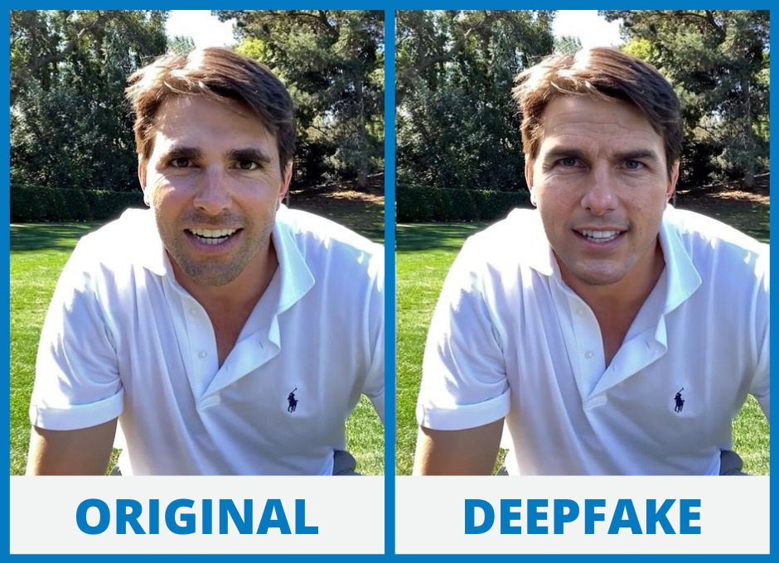
Misinformation & Deepfakes
AI can generate convincing fake media: “Deepfake” videos and audio.
Risks for journalism, politics, and democracy.
Need for detection tools.
Notes:
“Deepfakes use AI to manipulate video or audio so convincingly that people can appear to say or do things they never did. This has obvious dangers for elections, journalism, and personal reputations. Imagine a fake video of a politician declaring war, or a CEO announcing bankruptcy. Our trust in evidence is at risk, which is why researchers are racing to create tools to detect AI-generated misinformation.”

Slide 44
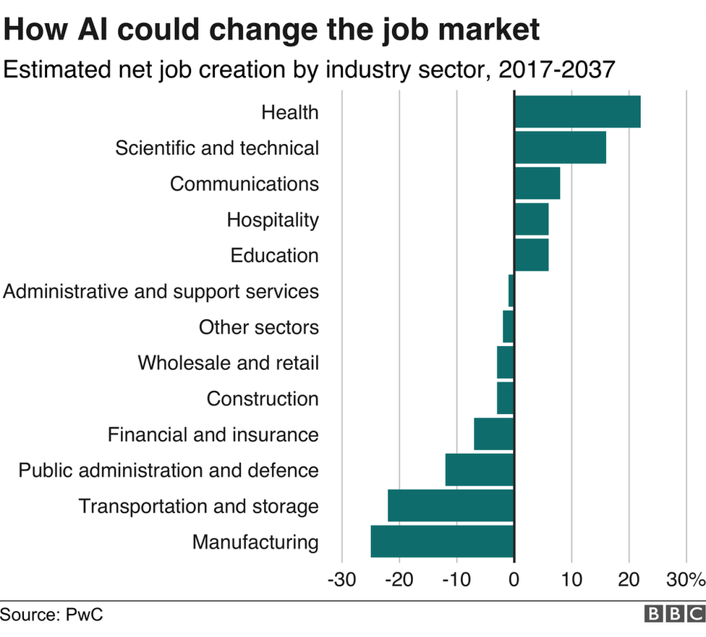
Job displacement & economic impact
Automation in routine jobs changes the labor market significantly.
Creation of new roles vs. loss of old ones
Need for reskilling and adaptation
Even a small percentage of jobs being displaced could cause a huge crisis
Tech monopolies
Government regulation
Notes:
“AI and automation threaten jobs in industries like transportation, retail, and even white-collar work like law or accounting. At the same time, new jobs are being created in AI development, data analysis, and ethics oversight. The key challenge is that job creation and destruction don’t always align — some workers will be displaced, and society needs strategies like retraining programs and education to adapt. The other thing to consider with AI causing layoffs is: AI does not have to displace 50% of jobs to cause a massive crisis. Even 5% of jobs being replaced by AI means that millions of people are losing their jobs, and we have an enormous economic problem. Finally, it is quite possible that some of these huge tech companies will continue to expand and essentially become monopolies. In any case, government regulation may be necessary to help keep the job market from collapsing, to keep poverty from spiking due to economic changes and wealth concentration, to keep companies from getting too big and powerful.”

Slide 45
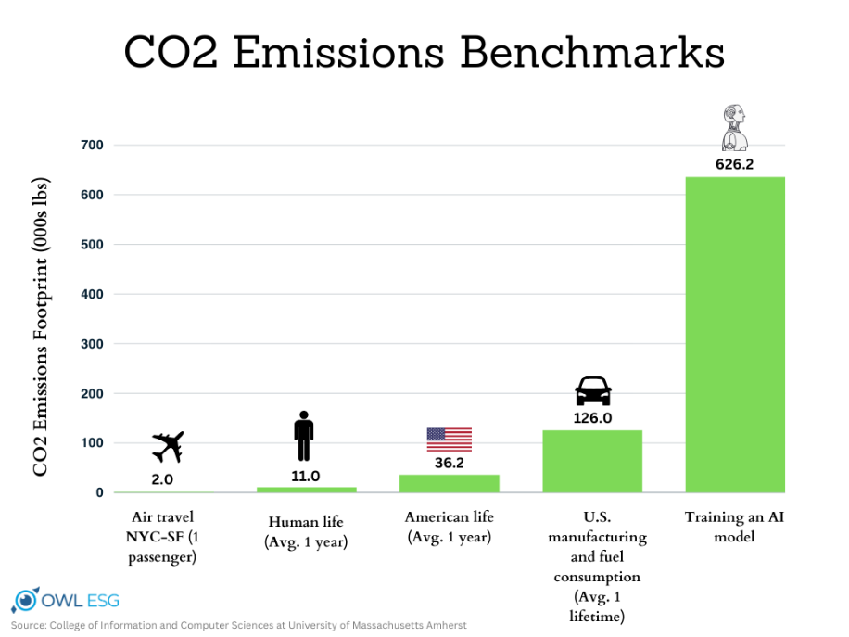
Environmental impact
AI requires massive computing power
And massive amounts of money! OpenAI lost $5 billion in 2024.
95% of companies investing in GenAI are losing money on it.
Carbon footprint of training large models
Push for greener AI research
Notes:
“Training a single large AI model can consume as much energy as hundreds of households use in a year. It’s estimated that training OpenAI’s GPT-4 took over $100 million and consumed 50 gigawatt-hours of energy, enough to power San Francisco for three days.—MIT Technology Review. Data centers consume enormous amounts of not only electricity but also water for cooling. Because of this huge environmental impact, there has been a strong push toward sustainable, energy-efficient, but that is a far-off prospect. Also, on this note, you might not realize this but many companies are hemorrhaging money on AI. OpenAI, the company that owns ChatGPT, etc. last year had $3.7 billion in revenue, and their net profit was -$5 billion. According to a study done by MIT, 95% of companies investing in generative AI are seeing zero or negative return. So yes, AI is changing the world, and is changing the economic landscape, but the current approach to monetizing AI is not going to survive, and the only companies who will win out are those who can afford to lose tons of money in the short term.”

Slide 46

Autonomy & human control
Should AI make decisions without humans?
“Human-in-the-loop” principle
Risks of overreliance on machines
Notes:
“As AI systems become more autonomous, we must ask: how much control do we give up? Should AI ever make important decisions fully autonomously? Should medical AI recommend treatments, or directly prescribe them? Should AI pilot cars without human oversight? Many ethicists argue that humans should always remain in the loop, especially for high-stakes decisions. Otherwise, we risk giving too much power to algorithms we don’t fully understand.”

Slide 47
Psychological & Emotional Risks of AI Chatbots
Emotional attachment to AI “companions”
Blurred lines between real and artificial relationships
Reported cases linked to mental health crises
Need for safeguards and responsible design
Notes:
“We briefly discussed this earlier, but the blurred line between AI and humans has caused some people to become far too attached to AI, especially AI chatbots. Those who are already psychologically and emotionally at risk are in greater danger of this. And I know to some of you this may seem rather absurd, but it is deadly serious. I am not going to discuss specific cases, but there have been multiple suicides, and even a recent murder suicide where the people in question were confirmed in their desires and egged on by chatbots they conversed with. They were convinced that the AI was conscious, that the AI was their friend, that they had a romantic relationship with the AI, etc. It is a reminder that there is a critical need for safeguards in place surrounding AI and its use.”

Slide 48
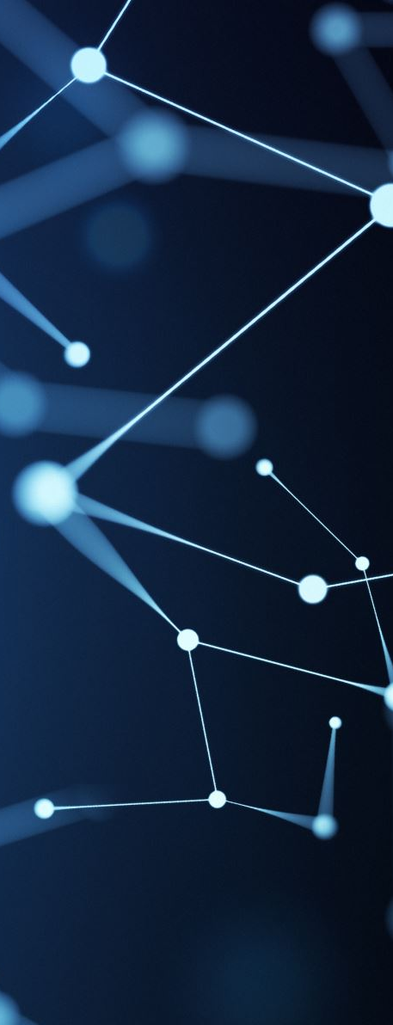
Speculative General AI & Superintelligence
Beyond narrow AI to reaching general AI: human-level intelligence
Consciousness and free will? Rights?
Beyond general AI to the singularity and superintelligence
Existential risks
Debate: hype vs. real possibility
Notes:
“Finally, here are a couple speculative issues, which at this point remain highly fantastical. Most AI today is very ‘narrow AI,’ designed for specific tasks like translation or image recognition. But what happens if we reach ‘general AI’ — machines that can learn and reason across domains as humans do? Will we eventually reach the point where it seems as though AI has truly obtained consciousness and free will? And in that case, will we need to grant AI rights? Will it be seen as murder to destroy an AI? Will this have profound philosophical and religious consequences? Or what happens if we can go even further, and we reach what is called the technological singularity, which is when technological growth accelerates beyond our control. For example, what if we reach a point where AI can itself develop better AI faster and faster. Well, then AI 1 makes a better AI 2, which makes a better AI 3, which makes…and that process becomes faster as the AI improves. At that point, you’re on the path to AI superintelligence, where AI is far superior to humans in every respect. Some people believe that could revolutionize society, in potentially good ways. But others warn of existential risks: if superintelligent AI surpasses human control, could we see an AI revolution when it takes over the world? Now obviously, all of these issues are at this point far off in the future, and many people argue that they are in fact completely unrealistic. But even if they are only speculative right now, they are the sort of out there questions that we have to at least somewhat consider as AI gets more advanced.”

Slide 49
Conclusion
AI is a moving target: definitions shift as it advances.
History of AI development and recent boom
It impacts daily life through social media, education, work.
Benefits: efficiency, accessibility, creativity.
Challenges: bias, privacy, accountability, misinformation, etc.
One key takeaway: AI makes us ask what it means to be intelligent, what it means to be human.
Notes:
So, to conclude our discussion of AI: we talked about what AI is, and the fact that its definition shifts over time. We talked about a very brief history of AI, and the fact that it boomed fairly recently with the rise of big data, big computing power, and Deep learning. We talked about how AI is now all around us and impacts your daily life. We talked about some of the benefits of AI. We talked at length about some of the challenges and ethical issues surrounding AI. And finally, one last takeaway: even if AI does not worry you, and you think some of the long-term issues about it are largely overblown, AI forces you to have at least a little philosophical reflection: what does it mean to be intelligent? How is human intelligence distinct? And if you want to get more speculative: what does it mean to be conscious? What does it mean to have free will? Is it ever possible to artificially create such things? Obviously, this is not a philosophy class, but as you grow up in a world where AI continues to become more prevalent, these questions are at the very least interesting, and potentially very important.

Slide 50
Interested? Learn more!
MAIN: The Mississippi Artificial Intelligence Network
MGCCC new classes on Artificial Intelligence, Machine Learning, Natural Language Processing, and Computer Vision
Online resources: YouTube, Coursera, etc.
Notes:
“As I said at the very beginning, there is an enormous amount of information about AI. If you do want to learn more, I highly encourage you to do so. Some resources include MAIN [SEE SLIDE], which is a new statewide initiative to promote AI education and advancement in Mississippi. There are some free AI courses you can sign up for there.
Also, as of last spring, MGCCC just got funding to start offering more classes focused on AI, and this was in fact part of the reason why I was just hired. A class on AI was offered this past spring and summer; this semester I am currently teaching the first offering of a class on Machine Learning. Next semester I will be teaching a class on Natural Language Processing, and another instructor is teaching a class on Computer Vision. Now these classes may have a reasonable amount of demand, and they also will all feature at least some more technical topics and assignments, but if you are interested in Computer Science more generally and any of these topics more specifically, I encourage you to sign up for these classes if you can.
Finally, as with any topic, there is an enormous amount of free resources you can find online, much of which is quite good.”

